Slide 1
Post-Market surveillance of Illumina products
Ivan Charkin, Jeff Leath, Alec Neff
MSDS 7330 project

Slide 2
Summary
The goal of this project is to collect the post-market data on the performance of products made by Illumina and organize the information into a database
The data are obtained from Twitter by scraping with a custom script
The data is collected and organized allowing additional value added activity

Slide 3
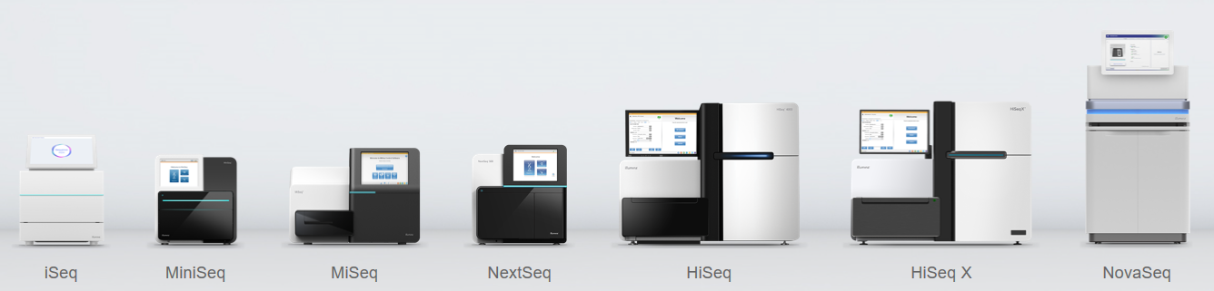
Illumina
Illumina is a leading company in the DNA sequencing market
It produces multiple platforms of DNA sequencers for various applications and consumables used for sequencing runs
The products are used for both research and medical diagnostics purposes (e.g. in-vitro diagnostics, cancer research)
www.illumina.com

Slide 4
Illumina
Illumina is a leading company in the DNA sequencing market
It produces multiple platforms of DNA sequencers for various applications and consumables used for sequencing runs
The products are used for both research and medical diagnostics purposes (e.g. in-vitro diagnostics, cancer research)
www.illumina.com

Slide 5

Post-market surveillance
For on-market products it is generally a good practice to proactively seek customer feedback on the product performance instead of relying on complaints only
For medical devices proactive collection of data is required per Federal Regulations as part of post-market surveillance to identify any problems with the product
The data are supposed to be collected during the whole time the product is on the market

Slide 6
Post-market surveillance
For on-market products it is generally a good practice to proactively seek customer feedback on the product performance instead of relying on complaints only
For medical devices proactive collection of data is required per Federal Regulations as part of post-market surveillance to identify any problems with the product
The data are supposed to be collected during the whole time the product is on the market

Slide 7
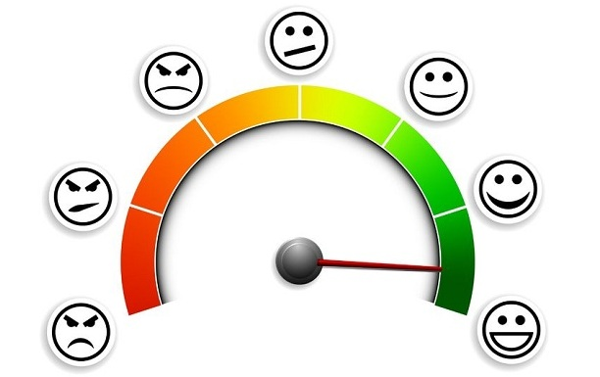
Examples of post-market data sources
Customer complaints – mostly reactive
Customer polls and questionnaires
Parts replacement data
Returns data
Clinical studies
Social media discussions and – focus of this project

Slide 8
Examples of post-market data sources
Customer complaints – mostly reactive
Customer polls and questionnaires
Parts replacement data
Returns data
Clinical studies
Social media discussions and – focus of this project

Slide 9

Data scraping
There are several specialized websites hosting discussion forums for specific applications of Illumina products, but the data access is limited
We chose Twitter since there are already scraping libraries available
The following keywords were used in preliminary runs:
Illumina
MiSeq
MiniSeq
NextSeq
NovaSeq
iSeq
HiSeq

Slide 10
Data scraping
There are several specialized websites hosting discussion forums for specific applications of Illumina products, but the data access is limited
We chose Twitter since there are already scraping libraries available
The following keywords were used in preliminary runs:
Illumina
MiSeq
MiniSeq
NextSeq
NovaSeq
iSeq
HiSeq

Slide 11
Data scraping cont.
Library("twitteR") is used to scrape data from Twitter
Limited success
Python (“Tweepy”)
tweet mode=’extended’
(full text)
json.dumps(tweet. json) command
JSON Format

Slide 12
“Tweepy”
author, contributors, coordinates, created at, destroy,
display text range, entities, favorite, favorite count,
favorited, full text, geo, id, id str, in reply to screen name,
in reply to status id, in reply to status id str,
in reply to user id, in reply to user id str, is quote status,
lang, metadata, parse, parse list, place, retweet

Slide 13
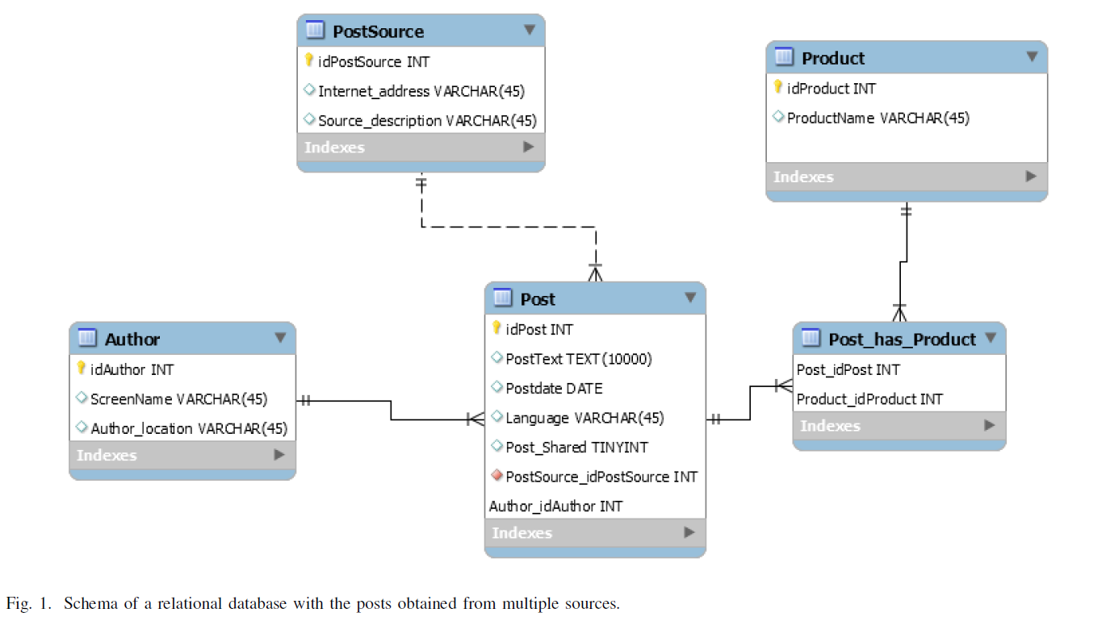
Database plan
Initial Plan
SQL

Slide 14
Database plan
Initial Plan
SQL

Slide 15
Database plan
Final Plan
MongoDB
Collection = “Illumina”
“mongoexport”
“upsert” function to append new records

Slide 16
Natural language processing
Queried MongoDB with Python
”full text” field for specific keywords
TextBlob ”translate” function
automatically detects the source language and translates

Slide 17
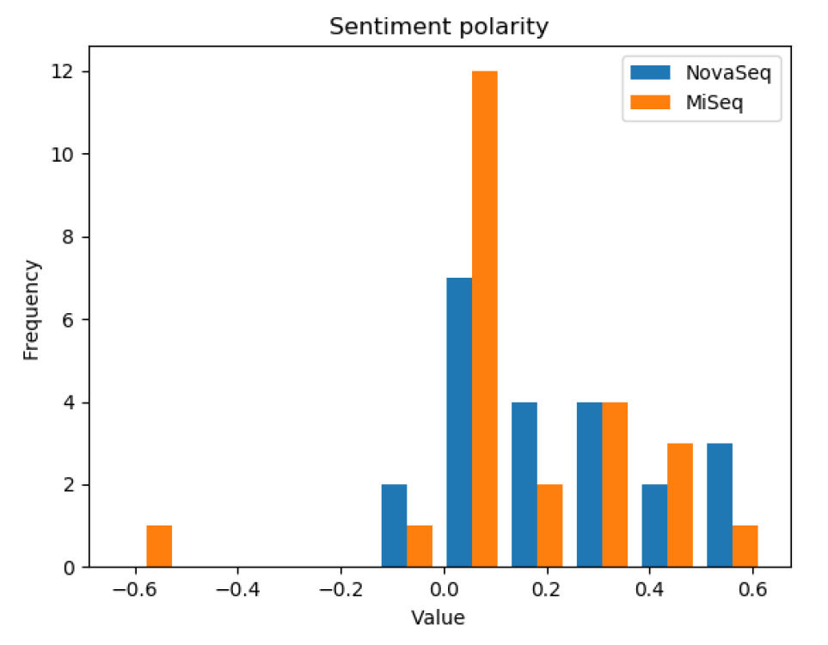


Natural language processing Sentiment Analysis

Slide 18
Natural Language Processing Sentiment Analysis “Pitfalls”!
”Just shy of 4 TeraBases for our S4 NovaSeq run. That is seriously mad!”
-Score very low
-Reality very positive

Slide 19
Conclussion
Unstructured data scrapped from internet
Created scalable database
Utilized DB for value added activity

Slide 20
Next steps
Collect more Twitter data
Include additional data sources
Enhance Database Schema based on the additional NLP package capabilities
Perform additional analysis using the database output

